Slide 1


Research Center
Data Science & Machine Learning
Extraction of Text from OCR Report
Guided by:
Dr. Sasmita Kumari Nayak, Asst. Professor
Dr. Sujata Chakravarty, Professor, Dean of SOET
Submitted by:
Kiran Kumar Malik (200301120128)
Sagar Kumar Ojha (200301120123)
Chandan Kumar Sahu (200301120188)
Branch: B-Tech in Computer Science and Engineering
Semester: 5th Sem
Date: 03.11.2022

Slide 2

01
Introduction
Future Scope
09
02
Objectives
Conclusion
10
03
Significances
Content
04
Methodology
05
Tools, Techniques, Hardware and Software requirements
06
Outcomes
07
Specific Learning
08
Skills acquired
2

Slide 3
Introduction
OCR stands for "Optical Character Recognition."
It recognizes text within a digital image. It is commonly used to recognize text from scanned documents and images.
OCR software can be used to convert a physical paper document, or an image into an accessible electronic version with text.
3

Slide 4
Objective
To build a OCR based text recognition system to extract text from image
To recognize text in scanned/Photo copy documents and images.
To convert a physical paper document, or an image into an accessible electronic version with text.
To create and train a model that detects text and recognize the text from an image using OCR and Tesseract
To extract the text from tabular format image to the respective rows and columns in excel or csv format
Handwriting recognition (HWR), also known as handwritten text recognition (HTR).
The ability of a computer to receive and interpret intelligible handwritten input from sources such as paper documents, photographs, touch-screens and other devices.

Slide 5
Significance
1
2
3
Image of tabular format to .CSV or .xlsx file
Image of paragraph text to .txt file
Image of Handwritten format to .txt file

Slide 6
Methodology
6

Slide 7
OCR Process
Normally, all the OCR tools process has five important steps. They are mentioned in following diagram:
Image capture
Image pre-processing
Document analysis
Segmentation
Data Extraction
Image Acquisition
Processing/Segmentation
OCR
Post Processing
Feature Extraction
Training a Neural Network

Slide 8
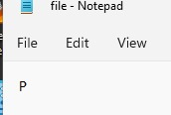

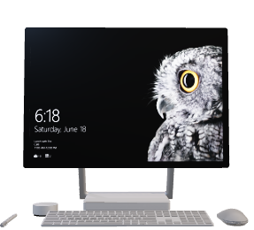
Tesseract OCR Architecture
Component Analysis Phase
Adaptive Binarization
Binary Image
Original Image
Contour Detection
Organization Words
Word detection, paragraphs lines
Two steps recognition
Editable Document

Slide 9
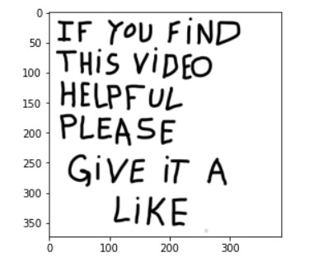
OCR process flow (Only text)
IF You FIND
THIS VIDEO
HELPFUL
PLEASE
GiVE iT A
LIKE
Input Image
Text format (output)
Tesseract-OCR Engine
Pre-Processing
Post-Processor
Trained Data Set
9

Slide 10
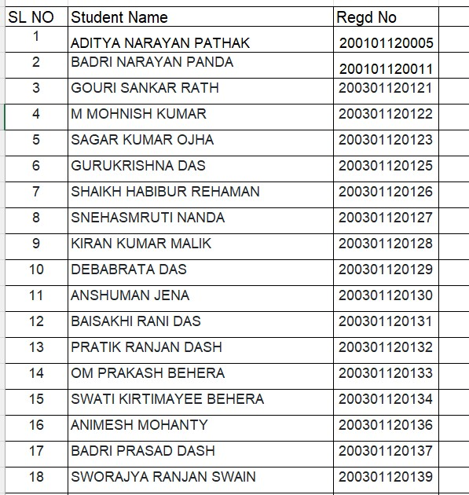
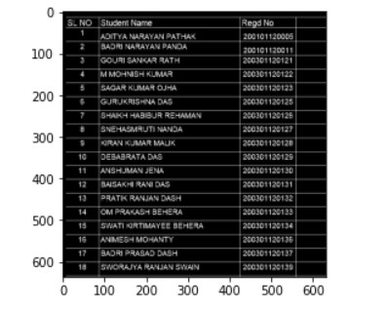
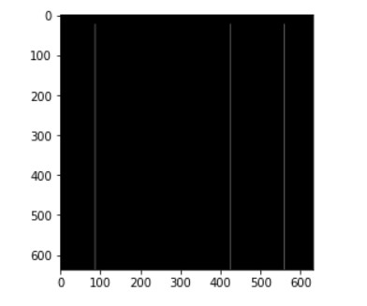
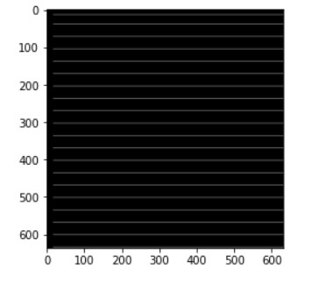
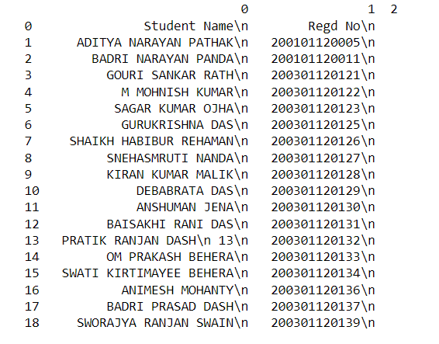
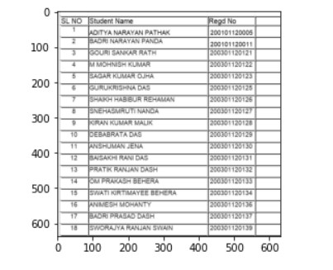

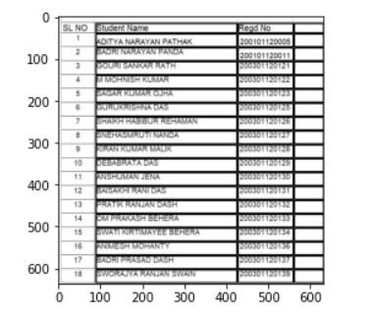
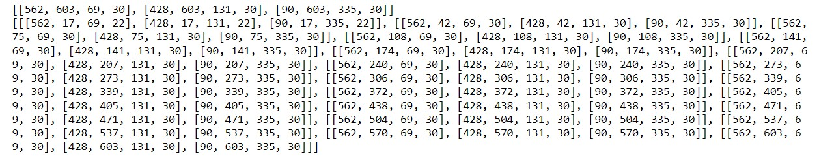
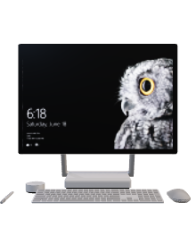
OCR process flow(CSV format)
Tesseract-OCR Engine
Input Image
Pre-Processing
vertical kernel to detect and save the vertical lines in a jpg
horizontal kernel to detect and save the horizontal lines in a jpg
Creating a dataframe of the generated OCR list and stored in .xlsx and .csv
Sorting the boxes to their respective row and column
Editable file
show the contour on image
Eroding and thresholding the image

Slide 11

OCR process flow(Excel format)
Tesseract-OCR Engine
Input Image
Pre-Processing
vertical kernel to detect and save the vertical lines in a jpg
horizontal kernel to detect and save the horizontal lines in a jpg
Creating a dataframe of the generated OCR list and stored in .xlsx and .csv
Sorting the boxes to their respective row and column
Editable file
show the contour on image
Eroding and thresholding the image

Slide 12
OCR process flow (Handwritten text)
Crop the images to documents Border
Detect and crop the all Documents
Pre-process word images
Is the word image is handwritten or not
YES
NO
Input
HTR using TF
Tesseract(OCR)
Concatenate the inferred words to from the whole text
OUTPUT
12
12

Slide 13
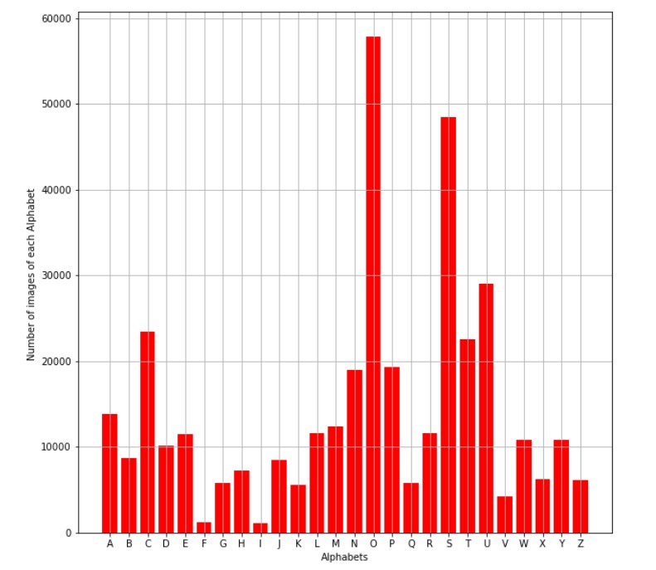
Dataset: Number of Handwritten letters
13

Slide 14
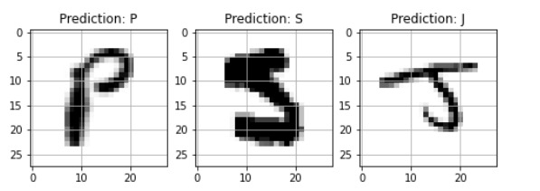
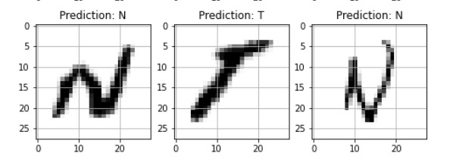
Prediction of handwritten letters
14

Slide 15
Tools, Techniques, Hardware and Software Requirements
15

Slide 16
Hardware and Software Requirements
H/W Requirements:
Processor: Any Processor above 500MHz
RAM: 8.00 GB
Input device: Standard Keyboard and Mouse.
System type: 64-bit operating system, x32-based processor
S/W Requirements:
Operating system: Windows, MacOS or Linux
Programming: Anaconda Navigator and Jupyter notebook
16

Slide 17
Installation Requirements
Environment
TensorFlow environment
Packages
Pytesseract
Imutils
EasyOCR
Libraries
OpenCV
Numpy
Pandas
Matplotlib
Scikit-learn
Model
CNN model
17

Slide 18
OUTPUTS
18

Slide 19
Output 1
IF You FIND
THIS VIDEO
HELPFUL
PLEASE
GiVE iT A
LIKE
Original Image (Input)
Text Format (Output)
19

Slide 20
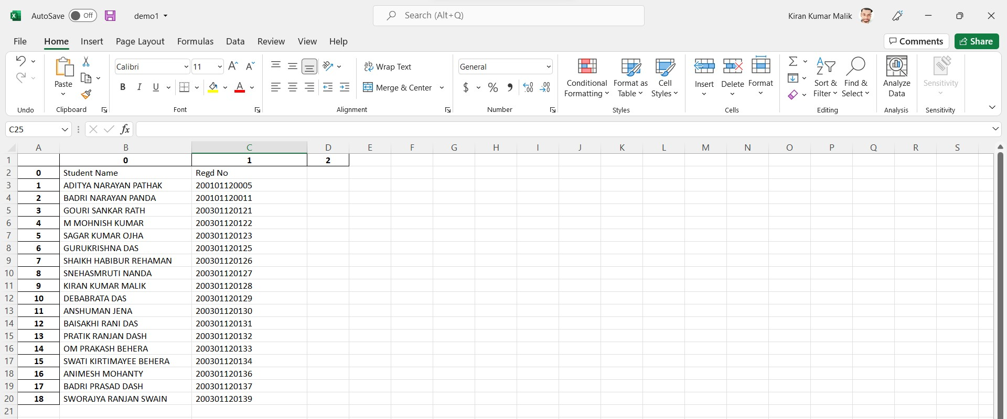
Output 2
.csv
Original Image (Input)
Editable Format (Output)
20

Slide 21
Output 3
.xlsx
Original Image (Input)
Editable Format (Output)
21

Slide 22
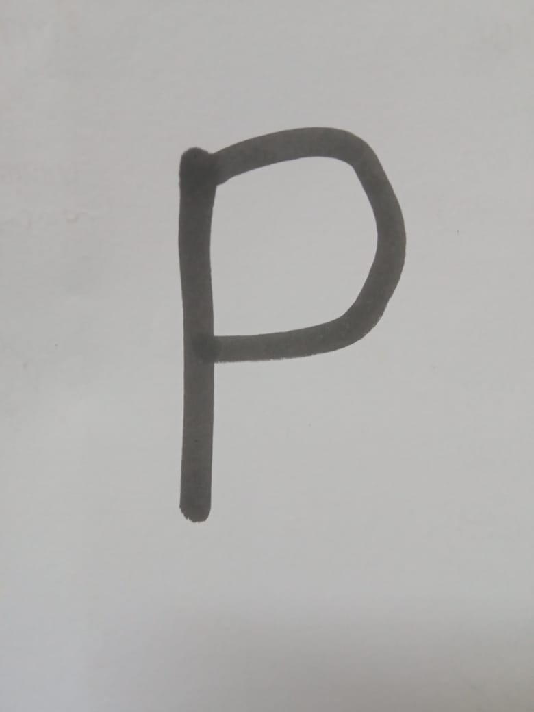
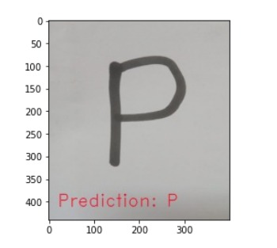
Output 4
.txt
Original Handwritten Image (Input)
Prediction (Processing)
Editable Format (Output)
22

Slide 23


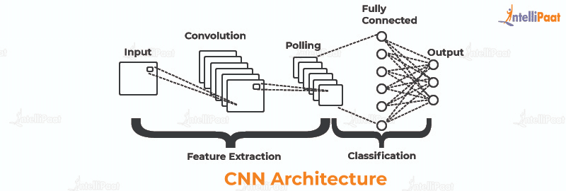
Specific Learning
We have learned the specific concept to solve this problem statement are
TensorFlow
Pytesseract
CNN model

Slide 24
Skills Acquired
After working in this 1000 summer internship and solving all the problem statements, We have acquired the skill of following points:
Active Listening
Confidence
Collaboration Work
Leadership
Presentation style
Analytics
Coding Languages
Critical Thinking

Slide 25
Conclusion
Given enough effort and sufficient research and development, OCR can become a powerful tool for future data entry application. However, the limited availability of funds in a capital-short environment could restrict the growth of this technology. But, given the proper impetus and encouragement, a lot of benefits can be provided by the OCR system. They are:
The automated entry of data by OCR is one of the most attractive, labour reducing technology.
The recognition of new font characters by the system is very easy and quick.
We can edit the information of the documents more conveniently and we can reuse the edited information as and when required.

Slide 26

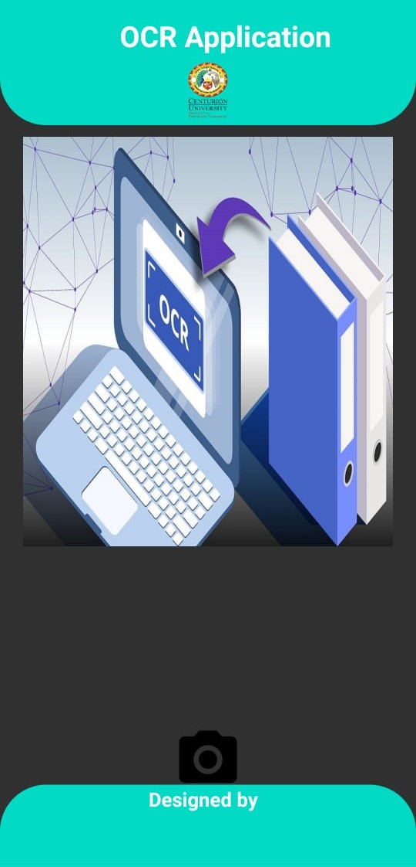

Future Scope
It can be implement as a website.
It can be implemented as an Android Application which is user friendly.
Server
API Request
API Response
Input Image
Output Text
Users
Application Interface

Slide 27

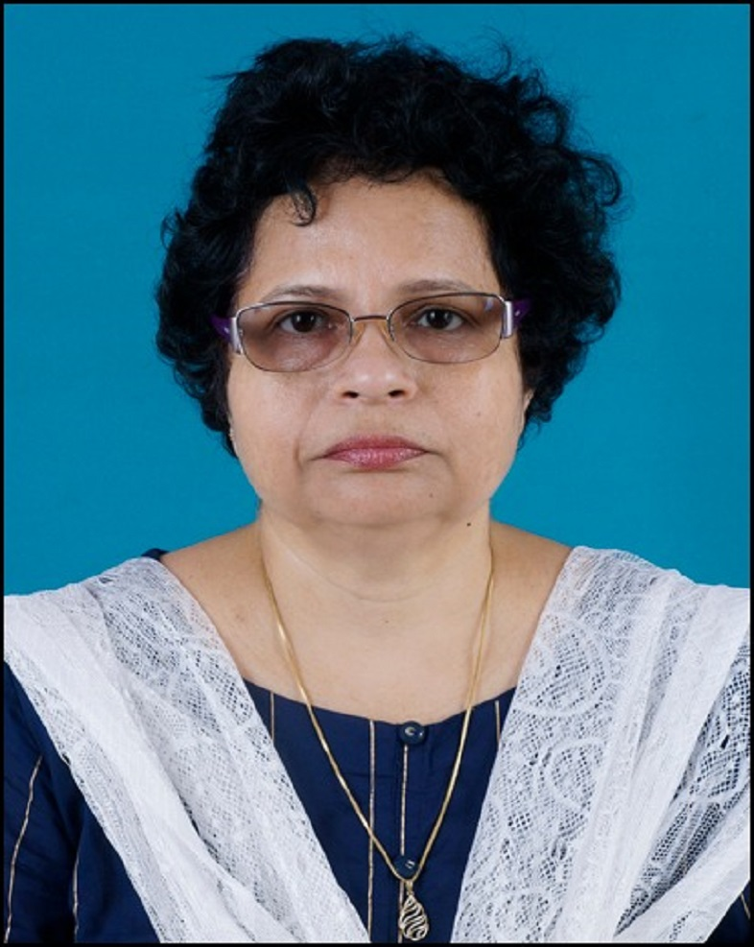
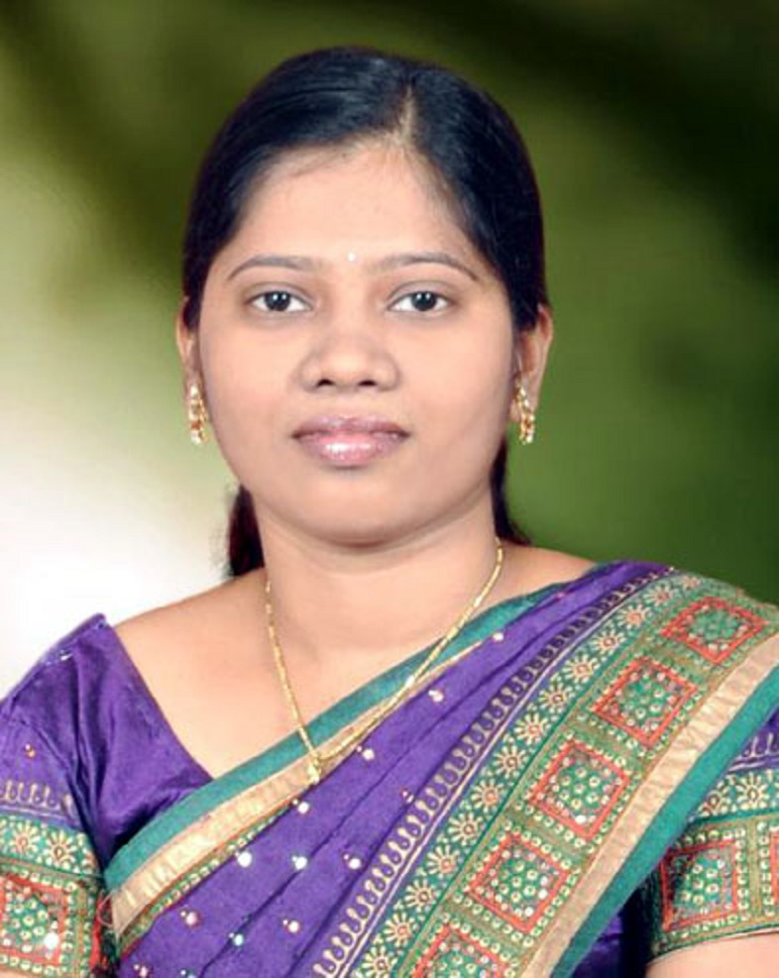

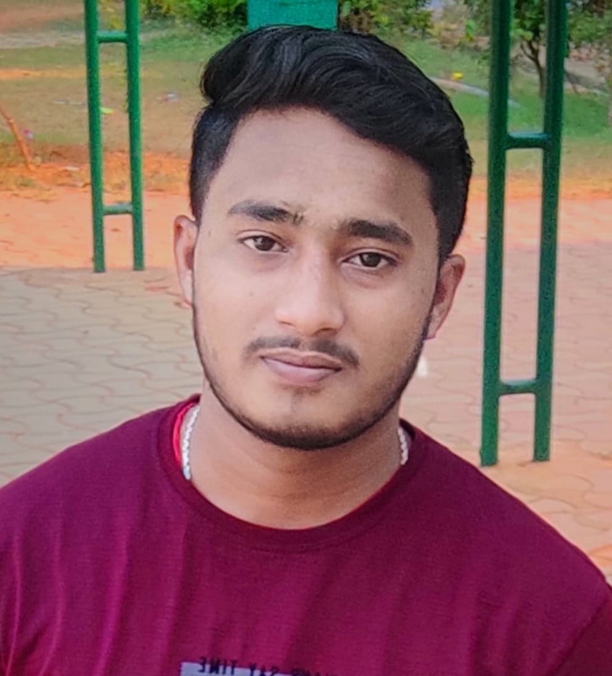
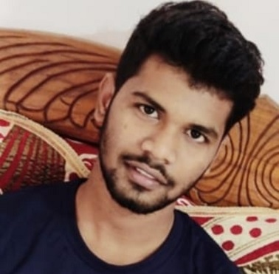
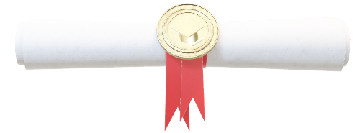
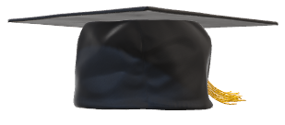

Research Center
Data Science & Machine Learning
Thank You !
Team Work
Dr. Sujata Chakravarty
Co-Ordinator/Professor,
Dean of SOET
Dr. Sasmita Kumari Nayak
Co-Ordinator/Asst. Professor
Kiran Kumar Malik
200301120128
Team Leader, B-Tech CSE
Sagar Kumar Ojha
200301120123
Teammate, B-Tech CSE
Chandan Kumar Sahu
200301120188
Teammate, B-Tech CSE

